Slide 1

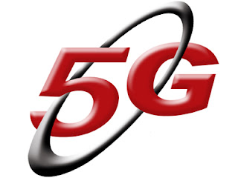
Presented By :
Gurpreet Singh Matharu (08311503109)
Pradeep Budhwar (08511503109)
Mohit Gupta (08811503109)

Slide 2
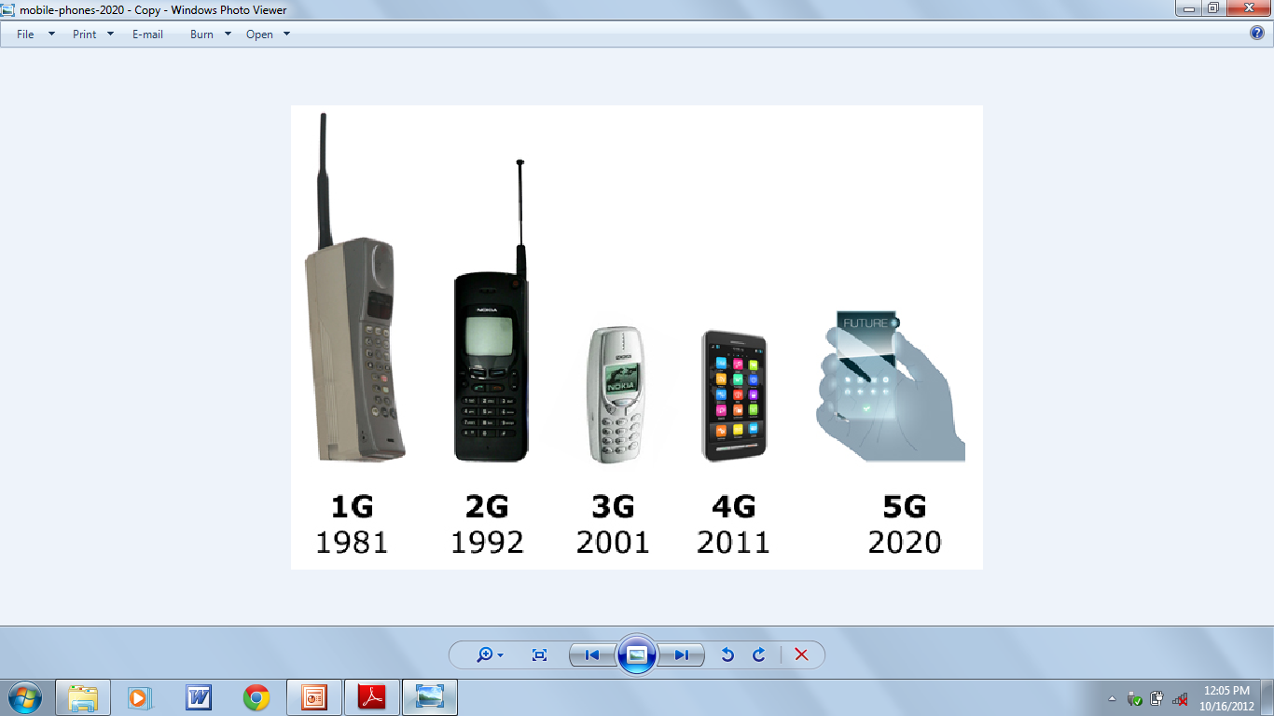
EVOLUTION FROM
0G to 5G SYSTEM

Slide 3
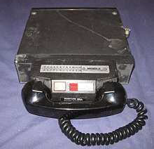
0G WIRELESS SYSTEM
Satellite phones were developed.
Available as a commercial service.
Part of the Public Switched Telephone Network
Part of a closed network such as a police radio or taxi dispatch system.
Mobile telephones were usually mounted in cars or trucks.
Models are in briefcase style.

Slide 4
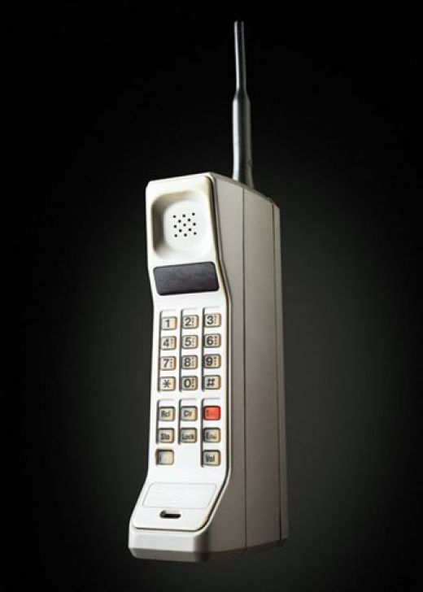
1G WIRELESS SYSTEM
Satellite phones were developed.
Developed in 1980s.
1G based on analog system.
Speed up to 2.4kbps.
Advance Mobile Phone System (AMPS)
launched by US.
Allows users to make voice calls in 1 country.

Slide 5
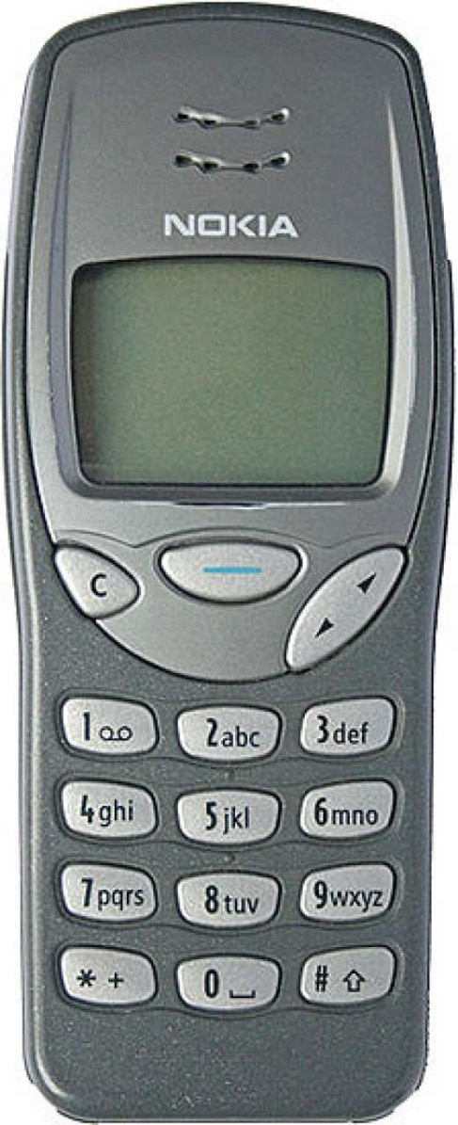
2G WIRELESS SYSTEM
Satellite phones were developed.
Fielded in the late 1980s and
finished in the late 1990s.
Based on digital system.
Speed up to 64 kbps.
Services such as digital voice with more
clarity and SMS.
Semi Global Facility

Slide 6
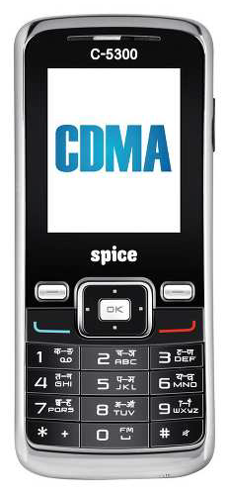
2.5G WIRELESS SYSTEM
Provide GPRS Service.
CDMA Multiplexing
Deliver data at high speed during browsing
Internet.
Data transmission rates of 144 kbps
Higher capacity packetized data.
2.5G system use 2G system infrastructure ,but it implements a packet – switched network.

Slide 7
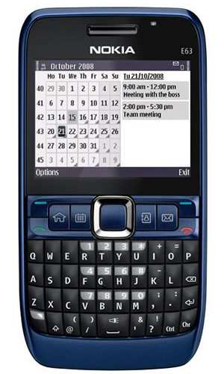
3G WIRELESS SYSTEM
Provide GPRS Service.
High-speed transmission upto 2 mbps.
Advanced multimedia access
Global roaming
Enhanced audio and video streaming.
Video-conferencing support.
Web and WAP browsing at higher speeds.
IPTV (TV through the internet ) support.
Offer greater security than its predecessors.

Slide 8
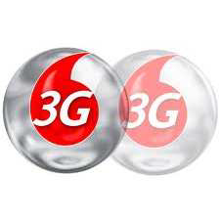
APPLICATIONS
Mobile TV
Video on demand
Video conferencing
Multiplayer gaming
Tele-medicine
Location based services
Wireless Advertising
DISADVANTAGES
Huge capital
required
High bandwidth
requirement

Slide 9
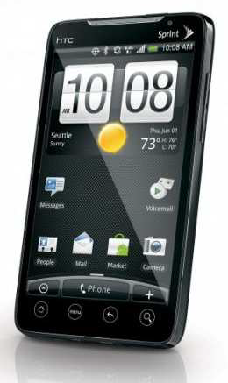
4G WIRELESS SYSTEM
Provide GPRS Service.
Has started emerging in the market.
Watch T.V. programs with the clarity as to that of an ordinary T.V.
Provided very smooth global roaming ubiquitously with lower cost.
Delivers 100 mbps to a roaming mobile device globally.
1 Gbps to a stationary device.
Larger bandwidth for data sharing is relatively inexpensive.

Slide 10
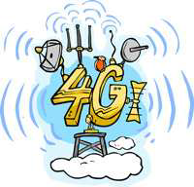
APPLICATIONS
Traffic Control
Disaster Management
Telemedicine
Telegeoprocessing
VoIP for IPV6
TECHNOLOGY
LTE
OFDM
Smart Antennas
DISADVANTAGES
Obtaining information from people
through illegal means becomes easier.
Increased invasion of privacy .

Slide 11
5G Technology
5G ( 5th generation mobile networks or 5th generation wireless systems ) is a name used in some research papers and projects to denote the next major phase of mobile telecommunications standards beyond the upcoming 4G standards.
Currently, 5G is not a term officially used for any particular specification.
5G Technology will be a complete wireless communication with almost no limitation and some Refer it to as REAL WIRELESS WORLD.
5G Technology is only theory and not yet real.
The 5G technologies include all type of advanced features which will make 5G mobile technology most powerful and in huge demand in near future.

Slide 12
Features of 5G Technology
5G technology offer high resolution for cell phone user and bi-directional large bandwidth shaping.
The advanced billing interfaces of 5G technology makes it more attractive and effective.
5G technology is providing large broadcasting of data in Gigabit which supporting almost 65,000 connections.
The traffic statistics by 5G technology makes it more accurate.
The 5G technology is providing up to 25 Mbps connectivity speed.
The uploading and downloading speed of 5G technology touching the peak.

Slide 13
WHAT CAN BE 5G?
An old man’s phone detects that it hasn’t moved for more than 2 hours, during his regular 2 hrs walk.
It issues an audible alarm, but no response!
The phone quickly sends an automated text
message to the specific numbers stored in the phone.
This is what I think of a “Fifth Generation” world,
also sometimes referred as the 5G world.

Slide 14
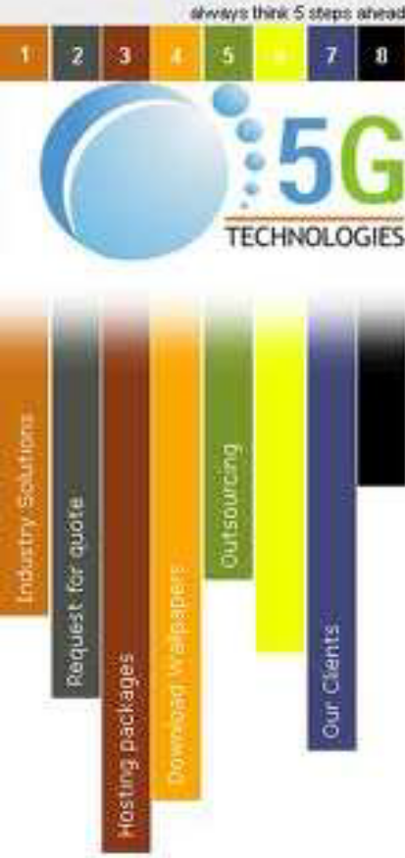
5G HARDWARE
UWB Networks – higher bandwidth at low energy levels.
Bandwidth- 4000 MBPS, which is 400 times
faster than today’s wireless networks
Smart antennas- Switched Beam Antennas,
Adaptive Array Antennas
Multiplexing- CDMA

Slide 15
5G SOFTWARE
5G will be single unified standard of different wireless networks, including wireless LAN technologies, LAN,WAN,PAN and wwww, Unified IP and seamless combination of broadband.
Software Defined Radio, Packet Layer, Implementation of Packets, Encryption, Flexibility, Anti-Virus

Slide 16

5G APPLICATIONS
Wearable device with AI capabilities.
Pervasive networks
Media Independent Handover
Radio Resource Management
High altitude stratospheric platform station systems.
VOIP enabled device

Slide 17

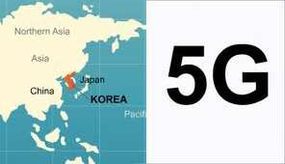
5G TELECOM SERVICES DEVELOPING COUNTRIES AND COMPANIES
JAPAN
KOREA
AFRICA
CHINA
NASA
APPLE
ARCHOS

Slide 18
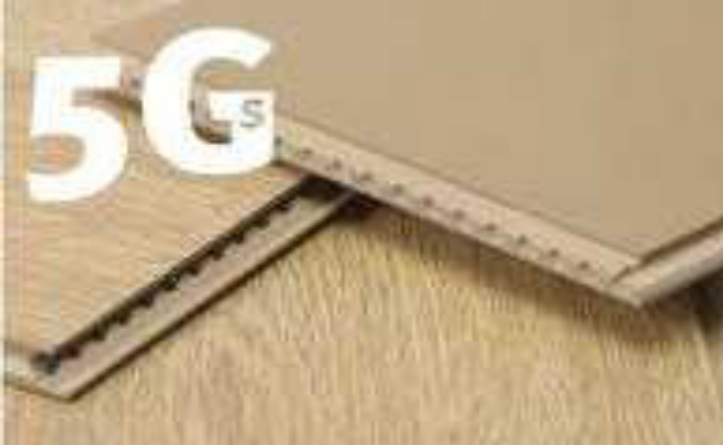
5G ADVANTAGES
DATA BANDWIDTH – 1gbps or higher
ZONE ISSUE- Globally accessible
SERVIES - Dynamic information access
COST - Beneficial to domestic user available at low cost

Slide 19
WHAT AFTER 5G…??
The 6G mobile technology is the next generation wireless mobile resources and the 6g technology will surely make a phenomenal changes in mobile technologies
The google hot trends has rated the 6g as the 17th most searched word in the search engines.

Slide 20

BIBLIOGRAPHY
1) http://en.wikipedia.org/wiki/5G
2) http://freewimaxinfo.com/5g-technology.html
3) http://www.5gtech.co.in/
4) http://en.wikipedia.org/wiki/4G
5) http://www.wisegeek.com/what-is-4g-mobile-technology.htm
6) http://freewimaxinfo.com/4g.html

Slide 21
THANK
YOU

